Slide 1
Cyclistic bike’s usage comparison
December 19, 2022
Daehee Kim

Slide 2
AGENDA
Objective
Analysis
Recommendations
Summary

Slide 3
Objective
To analyze how casual riders and annual members use Cyclistic bikes differently in order to design a new marketing strategy to convert casual riders into annual members.​

Slide 4
Analysis

Slide 5
Number of rides: overall
Annual Members make more trips

Slide 6
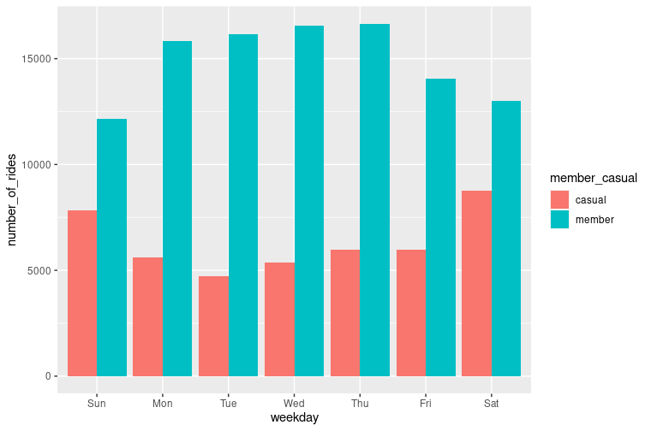
Number of rides: weekday
Annual members are consistent on weekdays and less on the weekend
Casual riders make most trips on the weekend

Slide 7
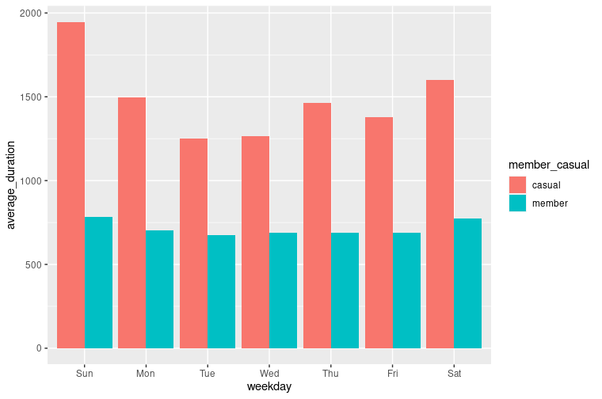
ride duration (in seconds): overall
Average ride duration is very consistent for annual members (less than 1000 seconds = 16.6 minutes)
Casual riders ride bikes for longer duration, especially on Sunday

Slide 8
Data information
Source: Cyclistic’s historical trip data from divvy-tripdata
Length: December 2021 to November 2022

Slide 9
Recommendations
It is proven that annual members take significantly more trips than casual users
Focus on increasing annual members
Annual members ride for a shorter duration and on weekdays
Weekday usage benefits for casual riders who converts to annual membership
Annual members’ average duration is very consistent throughout the week as casual riders have a longer rider duration over the weekend
Offer unlimited ride duration for casual riders who converts to annual membership for the first two months

Slide 10
SUMMARY
Cyclistic’s finance analysts have concluded that annual members are much more profitable than casual riders. The director of marketing also believes the company’s future success depends on maximizing the number of annual memberships.
From the trip data analysis, we learned that how annual members and casual riders differ. We will now design marketing strategies aimed at converting casual riders into annual members​ to build a brighter future for the company.

Slide 11
THANK YOU
Daehee Kim
dkim033@gmail.com
https://github.com/dkim033/Cyclistic-Divvy-CaseStudy

